Slide 2
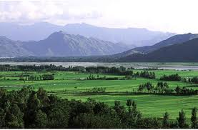
Swat & its People

Slide 3
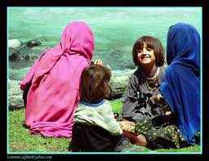

Slide 4
Survey Data
The survey is based on 1998 census of population numbering 1,257,602.
Swat has 65 union councils; Swat Tehsil has 52 UCs & Matta Tehsil 13.
13 union councils were selected from Swat & 3 from Matta Tehsil.
384 house holds were selected for random survey with a 5% degree margin of error.
16 FGDs & 39 key informants were also interviewed.

Slide 5
Hypothesis-1
Conflict doesn’t happen suddenly.
Deterioration in public service weaken the link with people
The poor & marginalized are future recruits for militants. A poor person will be a bad Pushtun
Many joined the insurgents because of asset deprivation— particularly land.
Years of mis-governance, and inability to provide justice, created platform for militancy
The Local Bodies Reform 2001 destroyed district management structure in Swat & provided militants space to grow. The MMA government was supportive.

Slide 6
Hypothesis-2
There is a close relationship between (some) Madrasah education and militancy.
The PATA Regulation 1969 reduced Human Rights and justice in Swat causing weak governance culminating in militancy.
Non regulation illegal broadcast through FM transmitters encouraged militancy and strengthened the TNSM and TTP in Swat. The female were more prone to FM broadcasts.
The government failed to check the militancy from 2002-2009 it led to the rise of militancy in Swat.

Slide 7
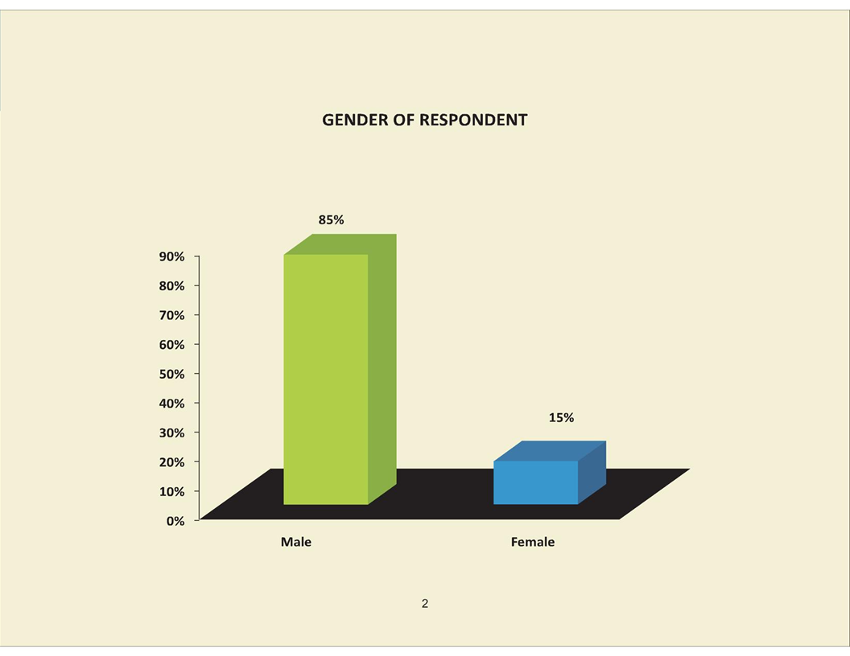

Slide 8
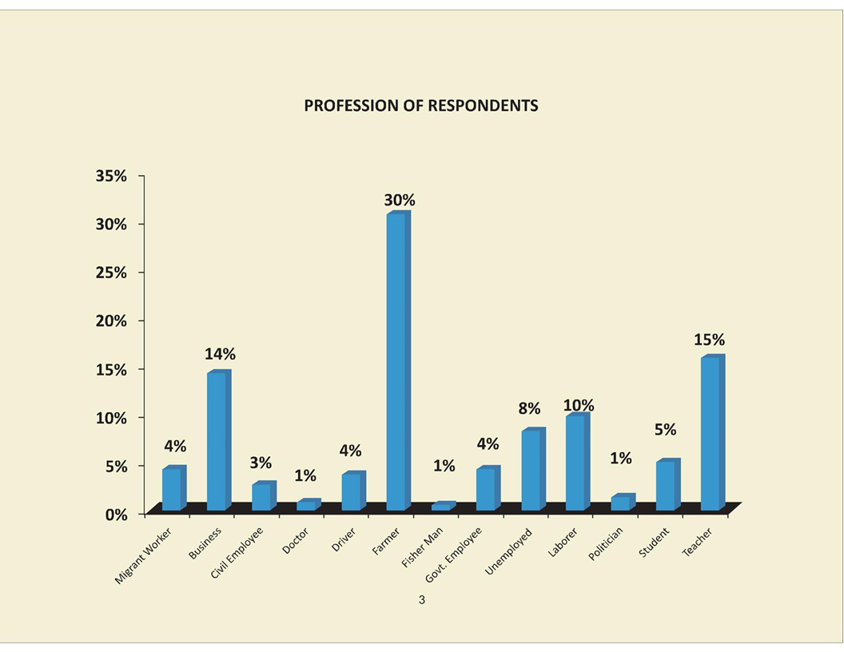

Slide 9
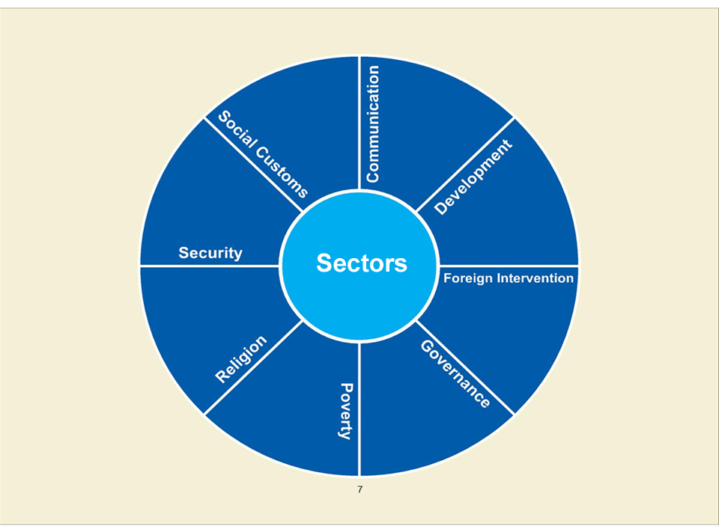

Slide 10
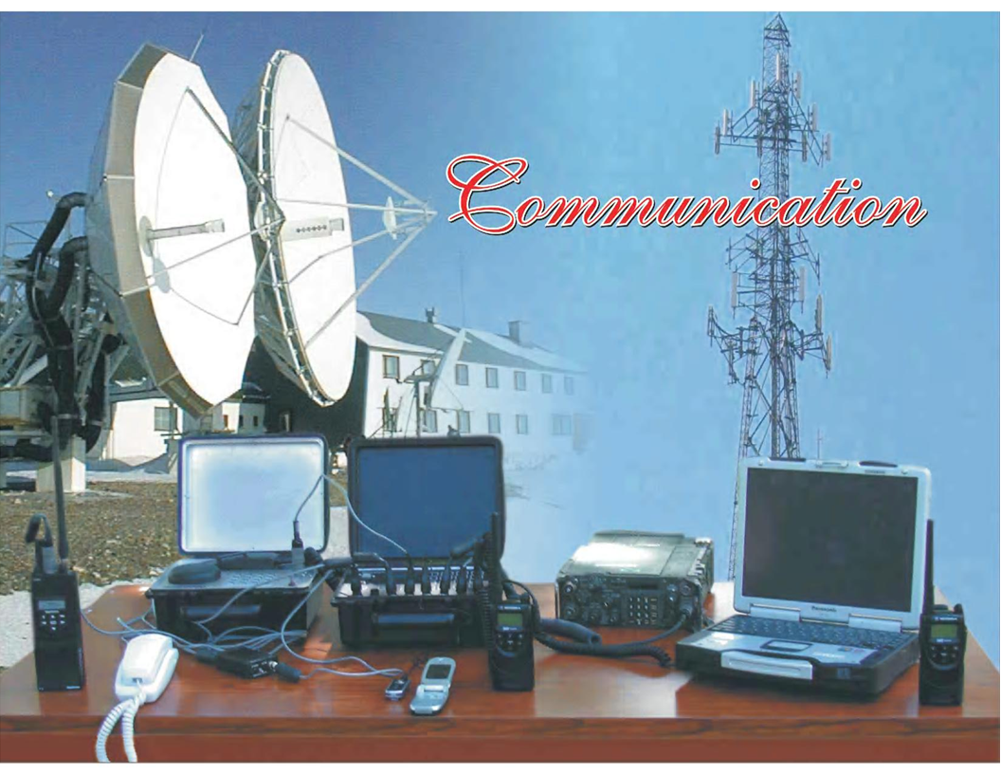

Slide 11
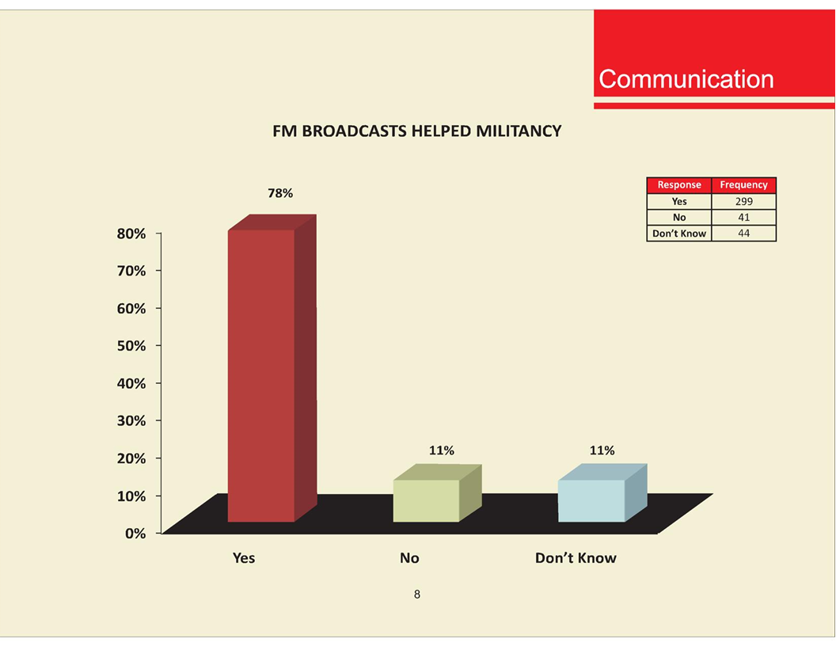

Slide 14
Comments on Communication
Pivotal role of Mullah Radio to win support and control society through fair.
Swat mosques were control by Afghan Refuges Mullah’s
FM Radio brainwashed the female who generated support within household.

Slide 16
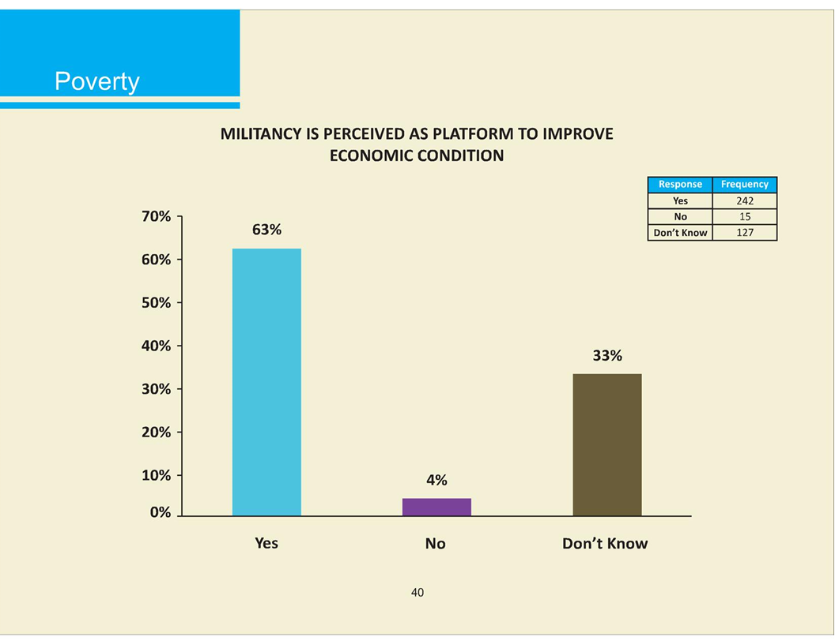

Slide 17
Labor force will increase from 51 million in
2005-06. By 2015 the LF will be 85 million & by 2023 it will rise to 95 million.

Slide 19
Comments on poverty
Below is a comparison of MDG development indicators of 2001 with 2005
In 2001 Swat was 15 out of 24 KP Districts; In 2005 it slipped to 17th position.
In Infant Mortality: It was 21 out of 24 (BA)
In Malnourishment: Swat was 23 out of 24 (BA)
In Primary School Enrollment: Swat was 11th (A)
In Adult Literacy: Swat was 9th (AA)
In Drinking Water: Swat was 9th (AA)
Poor Infant – Mother care with a migrant father produced child suicide bomber.

Slide 20
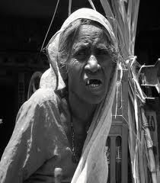
A Poor Woman

Slide 21
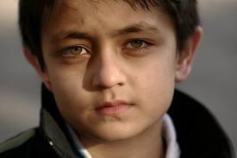
An Exploited Child

Slide 22
Project “Sabaoon”
Research of 126 child suicide bombers aged 8 – 14 years showed:
Most of the abducted children were picked up at random by militants
65 to 70% of the children's perform below their pair group in schools
Most of the children were school dropouts or did not attend
85% of the children were from large families 6 to 16 siblings
They suffered from lack of impulse control and aggressive tendency
They had headaches and hallucination and most suffered from seizures and epilepsy

Slide 23
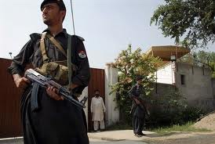

Slide 27
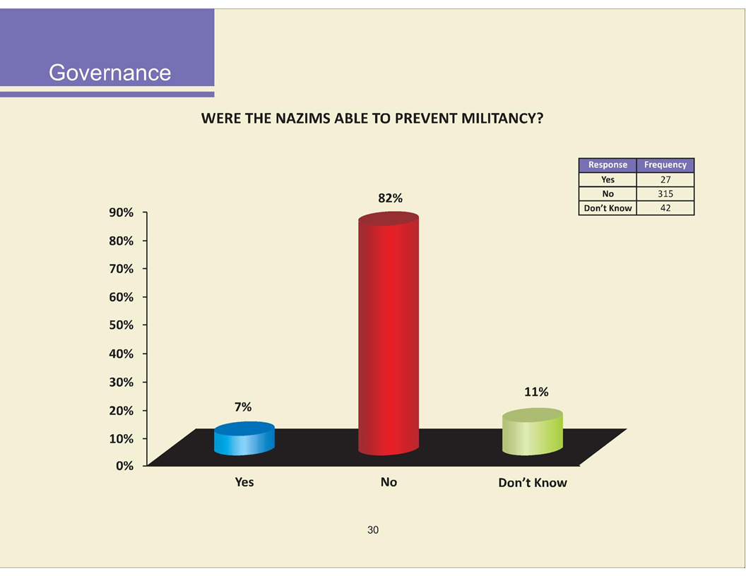

Slide 29
Comments on Governance - 1
After LGO Reforms 2001 the police magistracy system was broken; state control weakened
Local government power was transferred to feudals and peasants were marginalized
Protection to the week was not provided by Nazims
The MMA government were against the feudals thus district and provincial administration were in conflict.
There is a history of Yusufzai oppression of local nobility after their 15th Century invasion
After creation of Swat state in 1980 the Gujjars and Kohistanis were not allowed to owned land.
There was anger against the Khan’s and land redistribution was an issue

Slide 30
Comments on Governance - 2
Pakistan state contested by the secularist and the religious since 1947
Secularism is considered “Jayyhalia” that is living in sin.
Gen. Zia changed the laws and shifted the state to the right; the motto of the army became Iman (faith), Takwa (piety) & Jihad (fe sabil Allah)
The fight against USSR from 1979 to 1990 changed the social structures in Afghanistan and Pakistan
Three factors; a) the MMA government, b) local government reforms, c) week response to insurgency in FATA – were responsible for creating the insurgency.

Slide 31
Pushtun Dynamics
Jihad is used by the Pathan when the community feels threatened & a religious figure is chosen as leader.
In a land where social mobility is restricted, the madrasa becomes more than a learning institution. The Mullah & the Alim thus become influential and powerful. They become the leader of the weak, (Sufi Mohammad & Molvi Fazullah)
Many joint militants because of torture by security agencies

Slide 32
Constitutional Position of FATA & PATA
Art. 246 – 247 defines FATA, PATA & places them under GoP
Executive authority of federation applies to FATA
No act of Parliament will be enforced in FATA / PATA unless the President may so especially direct by a notification
The President may make any regulation for the good governance of FATA / PATA
The President has the power to end the classification of FATA / PATA over any area provided that the President shall ascertain the views of the tribe through a Jirga first
The jurisdiction of the Supreme and High Courts has been barred unless the Parliament so provides under a law

Slide 33
Recommendations (1)
Reform principles
Remove Malakand from Art 246 through executive order
of President
Focus on marginalized
Improve condition of females
Give priority to social protection & safety nets
Restore district administration for control
implement communication strategy
Political parties should recruit marginalized as members
Improve civil - military coordination
No military exit strategy
Absence of road map
Build civilian security capacity

Slide 34
"If somebody thinks that they are not under the government, they are mistaken. They are under the government and they remain under the government, because we are the elected representatives of the people of Pakistan.“
PM of Pakistan, (22-12-11)

Slide 35
Recommendations (2)
3. Poverty alleviation
Improve MDGs indicators for infant mortality, food intake,
adult education, drinking water & sanitation
Replicate income generating projects for the poor regions
4. Security Reforms
Amend LGO, Police Order 2000 & revive magistracy
Implement a monitorable police security plan
Create community based policing

Slide 36
Recommendations (3)
Mosque reforms
Mosques should be managed by communities under Regulation
Mosque should be declared as community schools
Madrasah integration
Should be integrated as schools for imparting primary education as mentioned under Art 25 A

Slide 37
Recommendations (4)
7. Delivery of justice
Cases of detainees be disposed
Disposal should be quick & fair
Introduce alternate dispute resolution system
8. Regulation of electronic media
Provincial authority be established
More FM stations on model of Amn radio

Slide 38
Recommendations (5)
9. Regulation of Afghan refugees
Camps are platforms for radicalization
Camps should be regulated & monitored by a high level
committee under Chief Secretary
No camps should be permitted in Malakand
10. Monitoring
Committee under Chief Secretary should be
established
11. Next steps
The report should be discussed in Cabinet
A reform implementation plan should be formulated
Indicators for measuring progress be introduced

